Slide 1
LOUISIANA DEPARTMENT OF NATURAL RESOURCES
Office of Conservation
TUSCALOOSA MARINE SHALE DEVELOPMENT
By
James H. Welsh
Commissioner of Conservation
September 12, 2013
Pineville, Louisiana
Notes:
Good evening, I am Jim Welsh, the Commissioner of Conservation. I oversee the Louisiana Office of Conservation and the oil and gas regulatory matters for the State of Louisiana. Today I will give you an overview of the T.M.S. (Tuscaloosa Marine Shale) development in Louisiana and a glimpse at our regulatory procedures with respect to how such a resource play is managed with respect to the environmental aspects of those operations.

Slide 2
Tuscaloosa Marine Shale
The T.M.S. is a geologic formation approximately 80 Million years old
Consists of fine-grained sediments: silts and clays “Shale”
Deposited in marine (ocean) environment
Approximately 500-600 feet thick (varies from area to area)
“Resistive” Section in lower portion of the interval (believed to be the most prospective part of the shale) is approximately 250 feet thick
Widespread deposition across LA-TX-MS “Eagle Ford” in TX. & West LA
Approximately 11,000 feet deep in Pineville area
Oil production (possible gas/gas condensate at greater depths)
Long known to have hydrocarbon potential
First T.M.S. wells in Louisiana drilled and produced in the 1970’s
Horizontal, hydrofractured wells currently used to produce the T.M.S.
Estimated reserve potential 7 Billion BBLS of oil (from L.S.U. Basin Research Institute 1997 study)
2
Notes:
What is the TMS? Here are some key points related to the TMS.

Slide 3
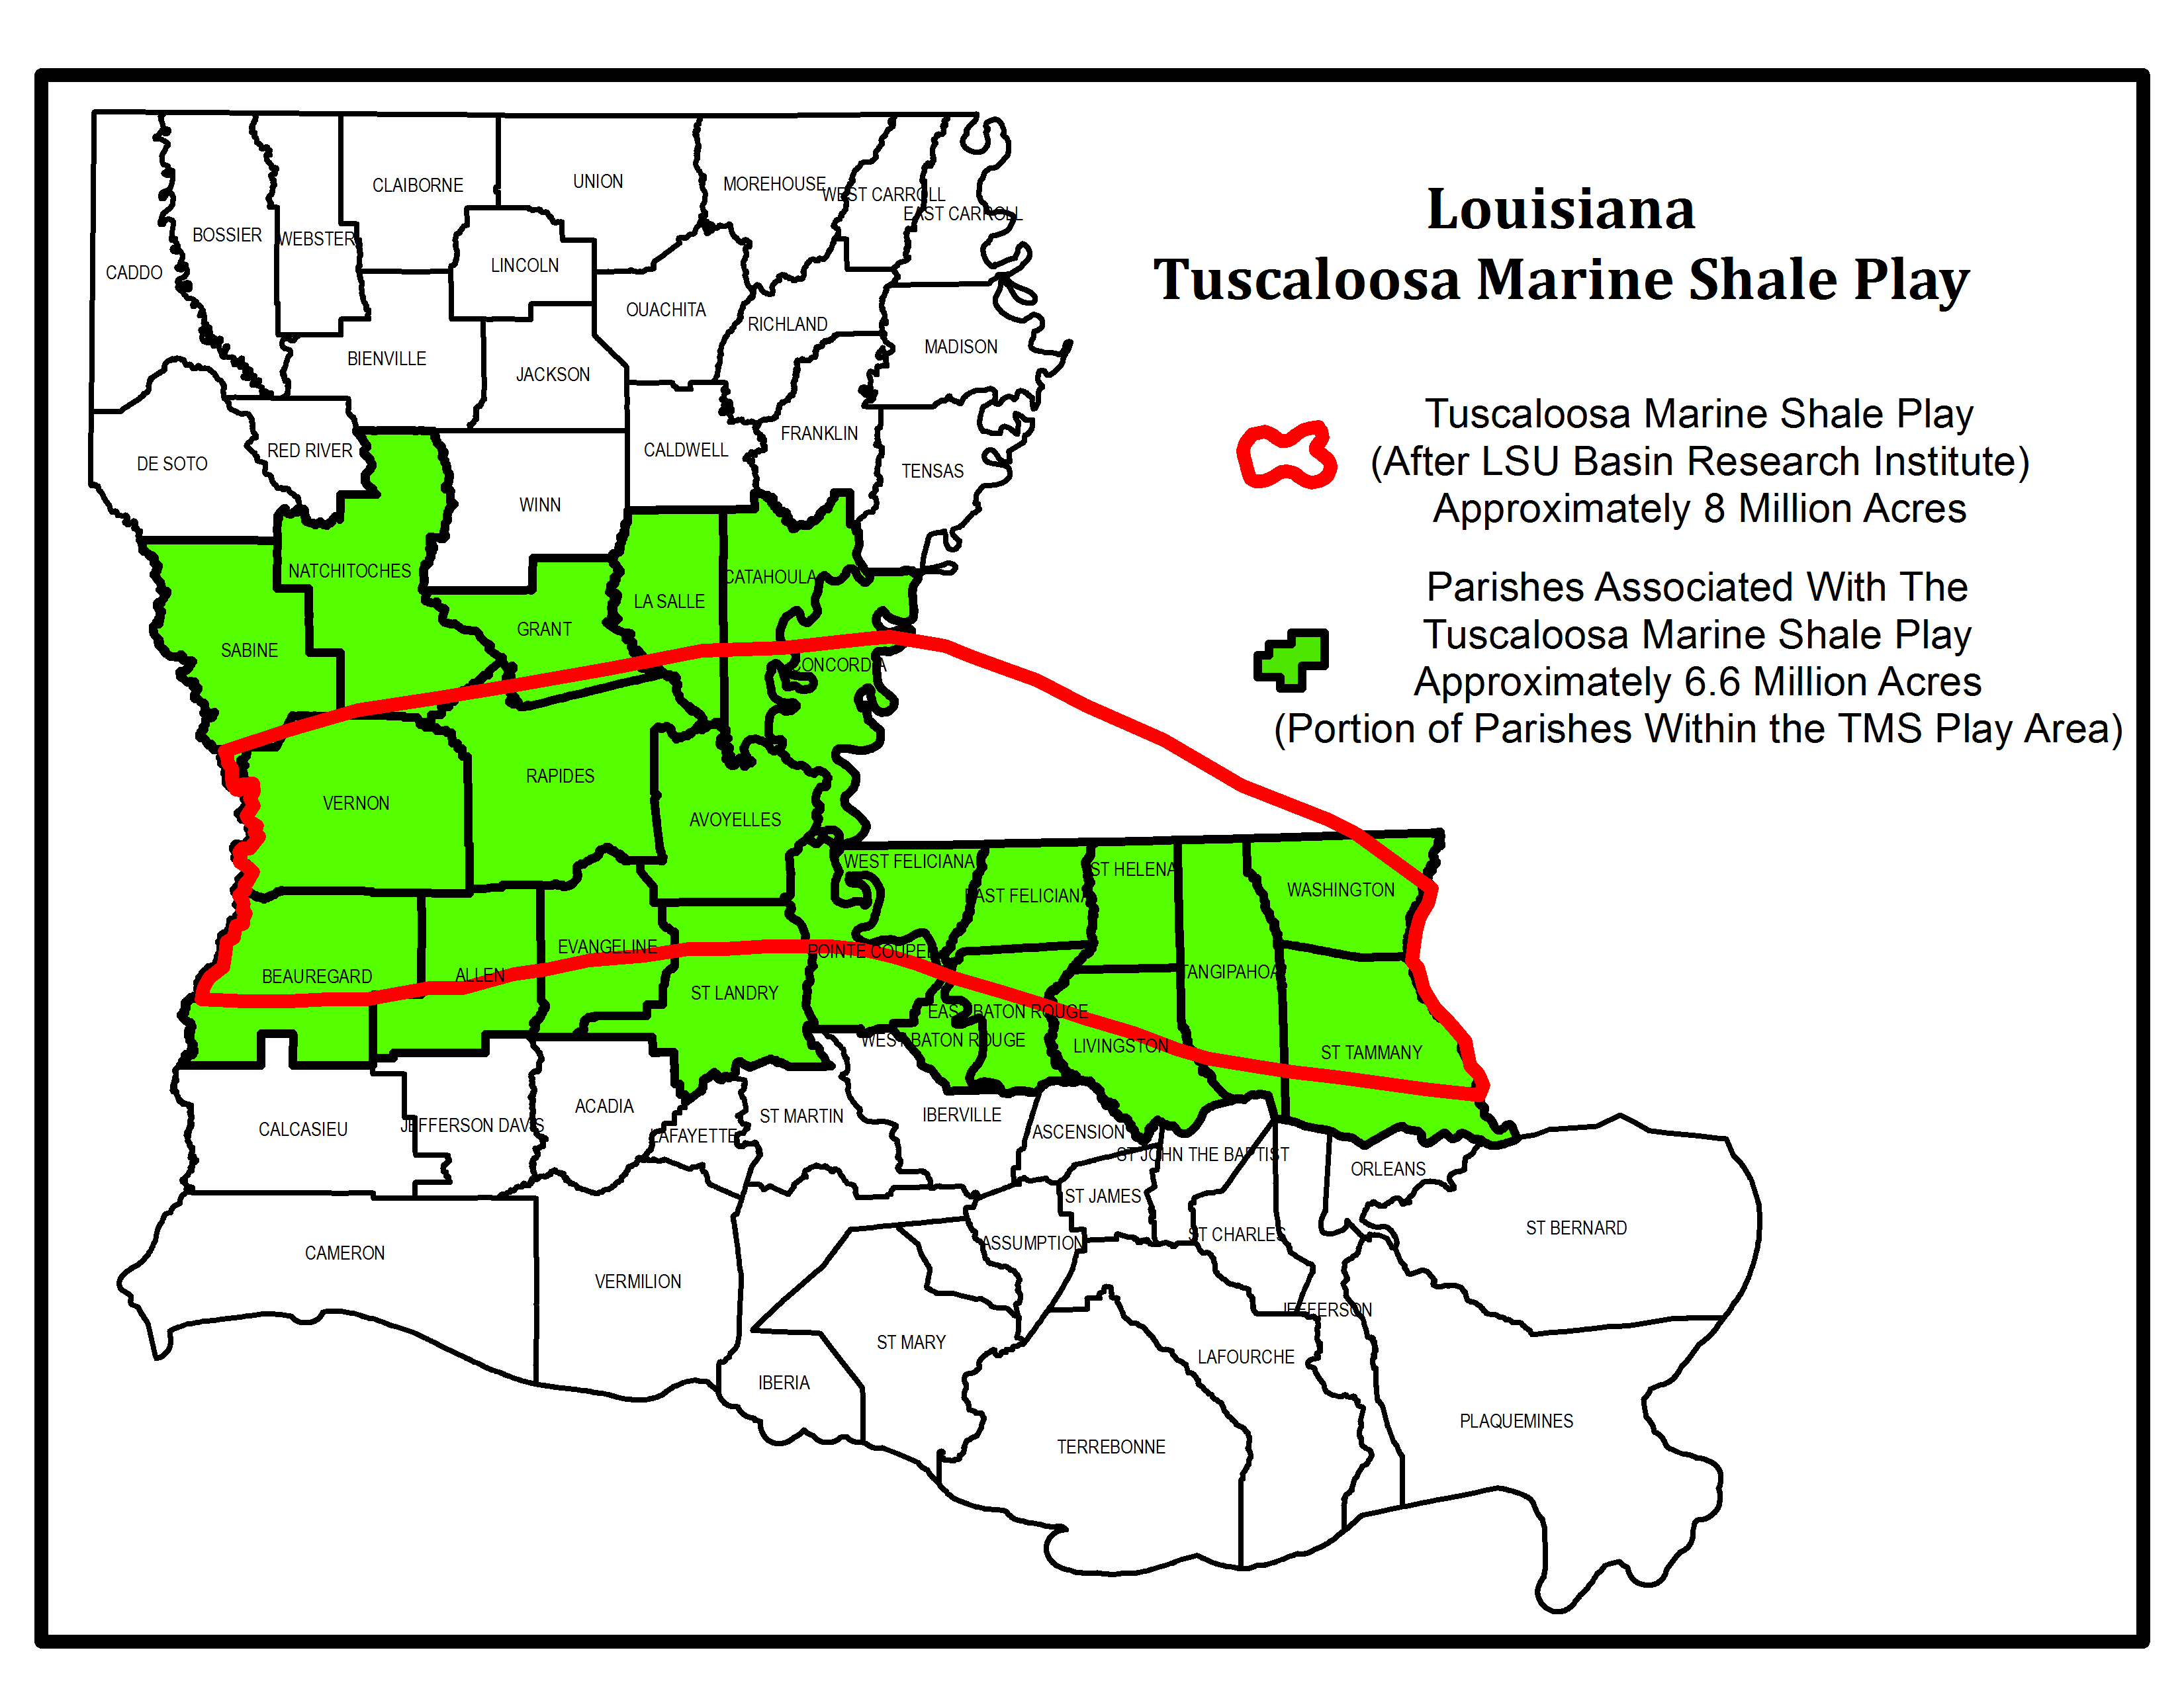
T.M.S. Trend in Louisiana
Pineville
3
Notes:
Where is the TMS trend in Louisiana? The TMS trend in Louisiana is located in the central part of the state. The green colored parishes are those that have some or all of the parish within the LSU Basin Research Institute’s TMS trend area, which is the red outline. This outlined area is the area thought to be the most favorable for oil reserves by the LSU BRI, taken from their 1997 study.

Slide 4
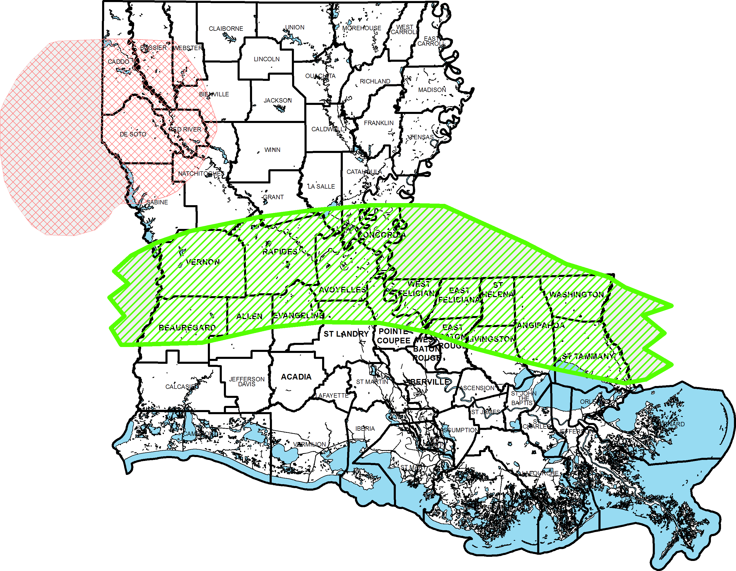
Tuscaloosa Marine Shale Play
Lower Smackover “Brown Dense” and Haynesville Shale Plays
^{BROWN DENSE}
^{Haynesville Shale}
^{Tuscaloosa Marine Shale}
Notes:
This slide shows the relationship of the TMS to the Haynesville Shale and Lower Smackover “Brown Dense” resource plays. These plays are similar to the TMS in that they also utilize horizontal wells and fracturing techniques to extract the hydrocarbons.

Slide 5
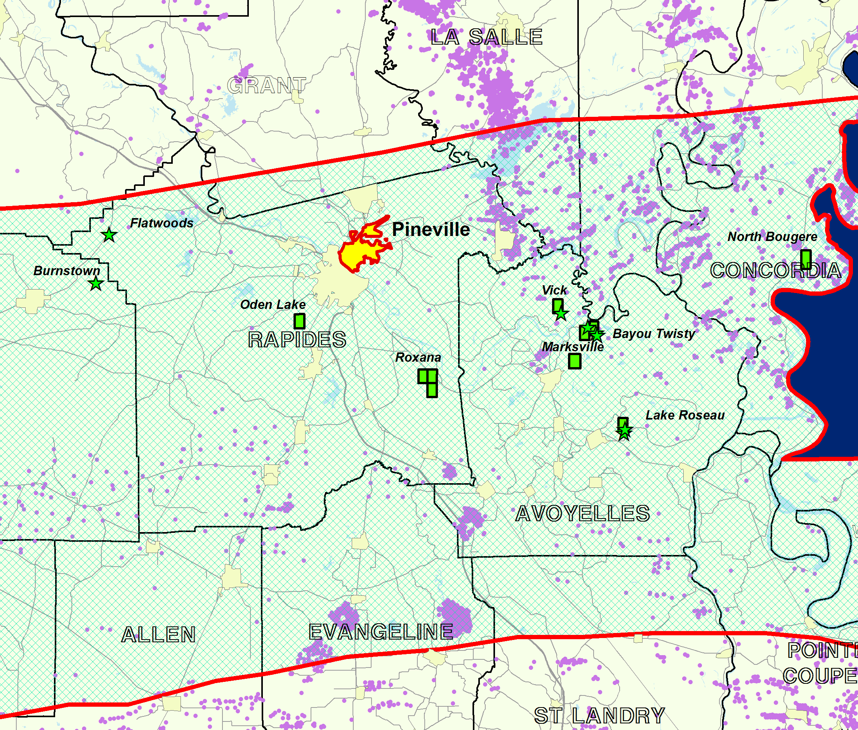
T.M.S. Trend Pineville Area
5
Notes:
TMS in Pineville Area. Pineville labeled and shown in yellow outlined in red. TMS units: green. TMS wells: green star. Purple: other oil and gas wells in area. Green cross-hatch area with red outline is Louisiana TMS area as per BRI study.

Slide 6

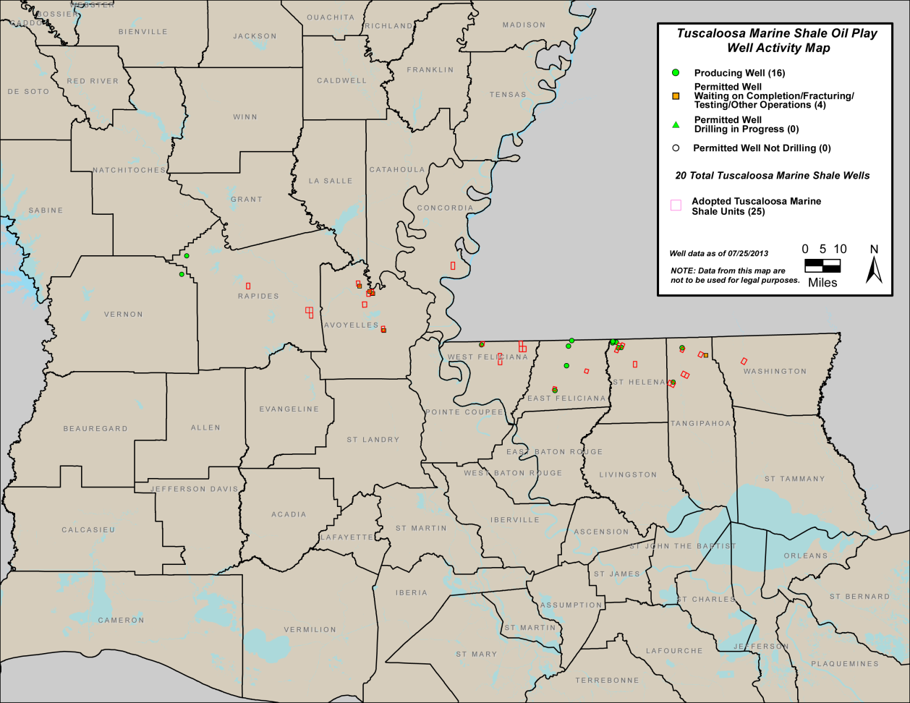
T.M.S. Statewide Activity
22 Total Wells Drilled to T.M.S
18 Wells Producing in T.M.S
25 Units Adopted for T.M.S
Web Address for Weekly T.M.S. Update:
http://dnr.louisiana.gov/assets/OC/tuscaloosa_shale/TMS.pdf
6
Notes:
Current TMS Activity statewide. Majority of current activity is in the “Florida Parishes” east of the Mississippi River. Web site updated weekly on Tuesdays. Shows latest well and unit stats. There is also an interactive GIS map on this site as well which allows you to click on individual wells and units to get more information.

Slide 7
Louisiana T.M.S. Production
Total Cumulative Production for T.M.S. : 584,532 BO
Last Reported Monthly Production for T.M.S Wells : 1109 BO
Total Wells Producing the T.M.S : 18
7
Notes:
Total TMS production in Louisiana to date is 584,532 barrels of oil. The TMS well come on at rates from 500 bbls/day or more and then eventually decline to much lower daily rates. This is common for the trend and companies are working to find ways to enhance the recovery using horizontal wells, hydro-fracking and special completion techniques to try to achieve higher daily rates.

Slide 8
T.M.S. Operators
T.M.S. Operators in Louisiana
Most Recently Active Operators:
Encana
Devon Energy
Goodrich Petroleum
EOG Resources
Indigo II Louisiana
Justiss Oil Company
Prior Operators Since Inception of Play
Texas Pacific Oil Company
Callon Petroleum
Exchange Oil and Gas
Encore
8
Notes:
Operators in the TMS Trend: Encana, Devon Energy, Indigo, Goodrich and EOG Resources. Goodrich recently purchased a large position in the TMS play from Devon Energy.
Former operators were Exchange Oil and Gas, Justiss Oil Company, Encore, Callon Petroleum and Texas Pacific Oil Company.

Slide 9
T.M.S. Fields
Rapides Parish
Flatwoods
Roxana
Oden lake
East Feliciana Parish
Richland Plantation
Beech Grove Plantation
Ethel
Clinton
Tangipahoa Parish
Greenlaw
Little Silver Creek
Northwest Wilmer
Fluker
Kentwood
Vernon Parish
Burnstown
Avoyelles Parish
Bayou Twisty
Lake Roseau
Vick
Marksville
West Feliciana Parish
Baker Creek
Lake Rosemound
Bayou Sara
Spillman
Northeast Spillman
Washington Parish
Franklinton
St. Helena Parish
Chipola
North Chipola
Northwest Liverpool
Joseph Branch
Concordia Parish
North Bougere
Notes:
TMS Fields. Some Fields have not been drilled yet, but have had units formed.

Slide 10
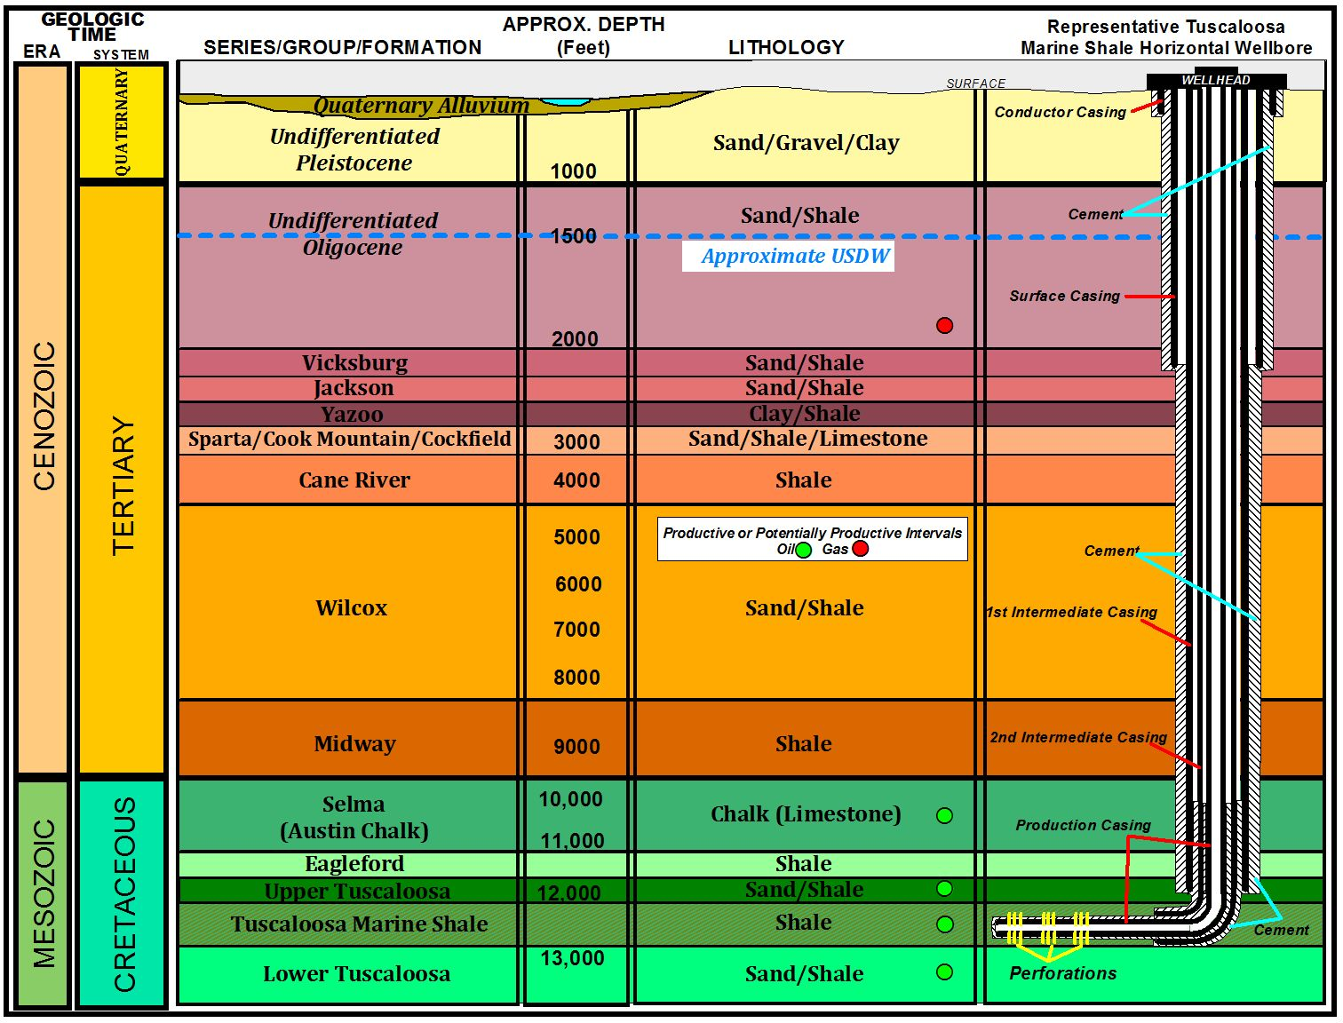
T.M.S. Generalized Horizontal Well
10
Notes:
Generalized Stratigraphic (geologic layering of rock units, “strata”) chart showing the relationship between the TMS and other formations with a representative wellbore diagram to depict the casing construction and the completion in the horizontal section of the well. Note the multiple casings that cover and protect the underground drinking water by being placed through the USDW interval and cemented, followed by two intermediate casing strings and the final production casing. The number of intermediate strings may vary with the depth to the target interval. No scale intended, for wellbore detail purposes. Formation depths are approximate for the Pineville area.

Slide 11
Protection of Groundwater Through Well Construction
Construction requirements result in protection of USDW and isolation of hydrocarbon bearing zones.
  Multiple casing strings
  Minimum setting depth
  Cement requirements
  Pressure testing
^{5 in.}
^{Production}
^{7 ⅝ in.}
^{Intermediate}
^{10 ¾ in.}
^{Surface}
Notes:
This is a close-up of a typical well casing construction.

Slide 12
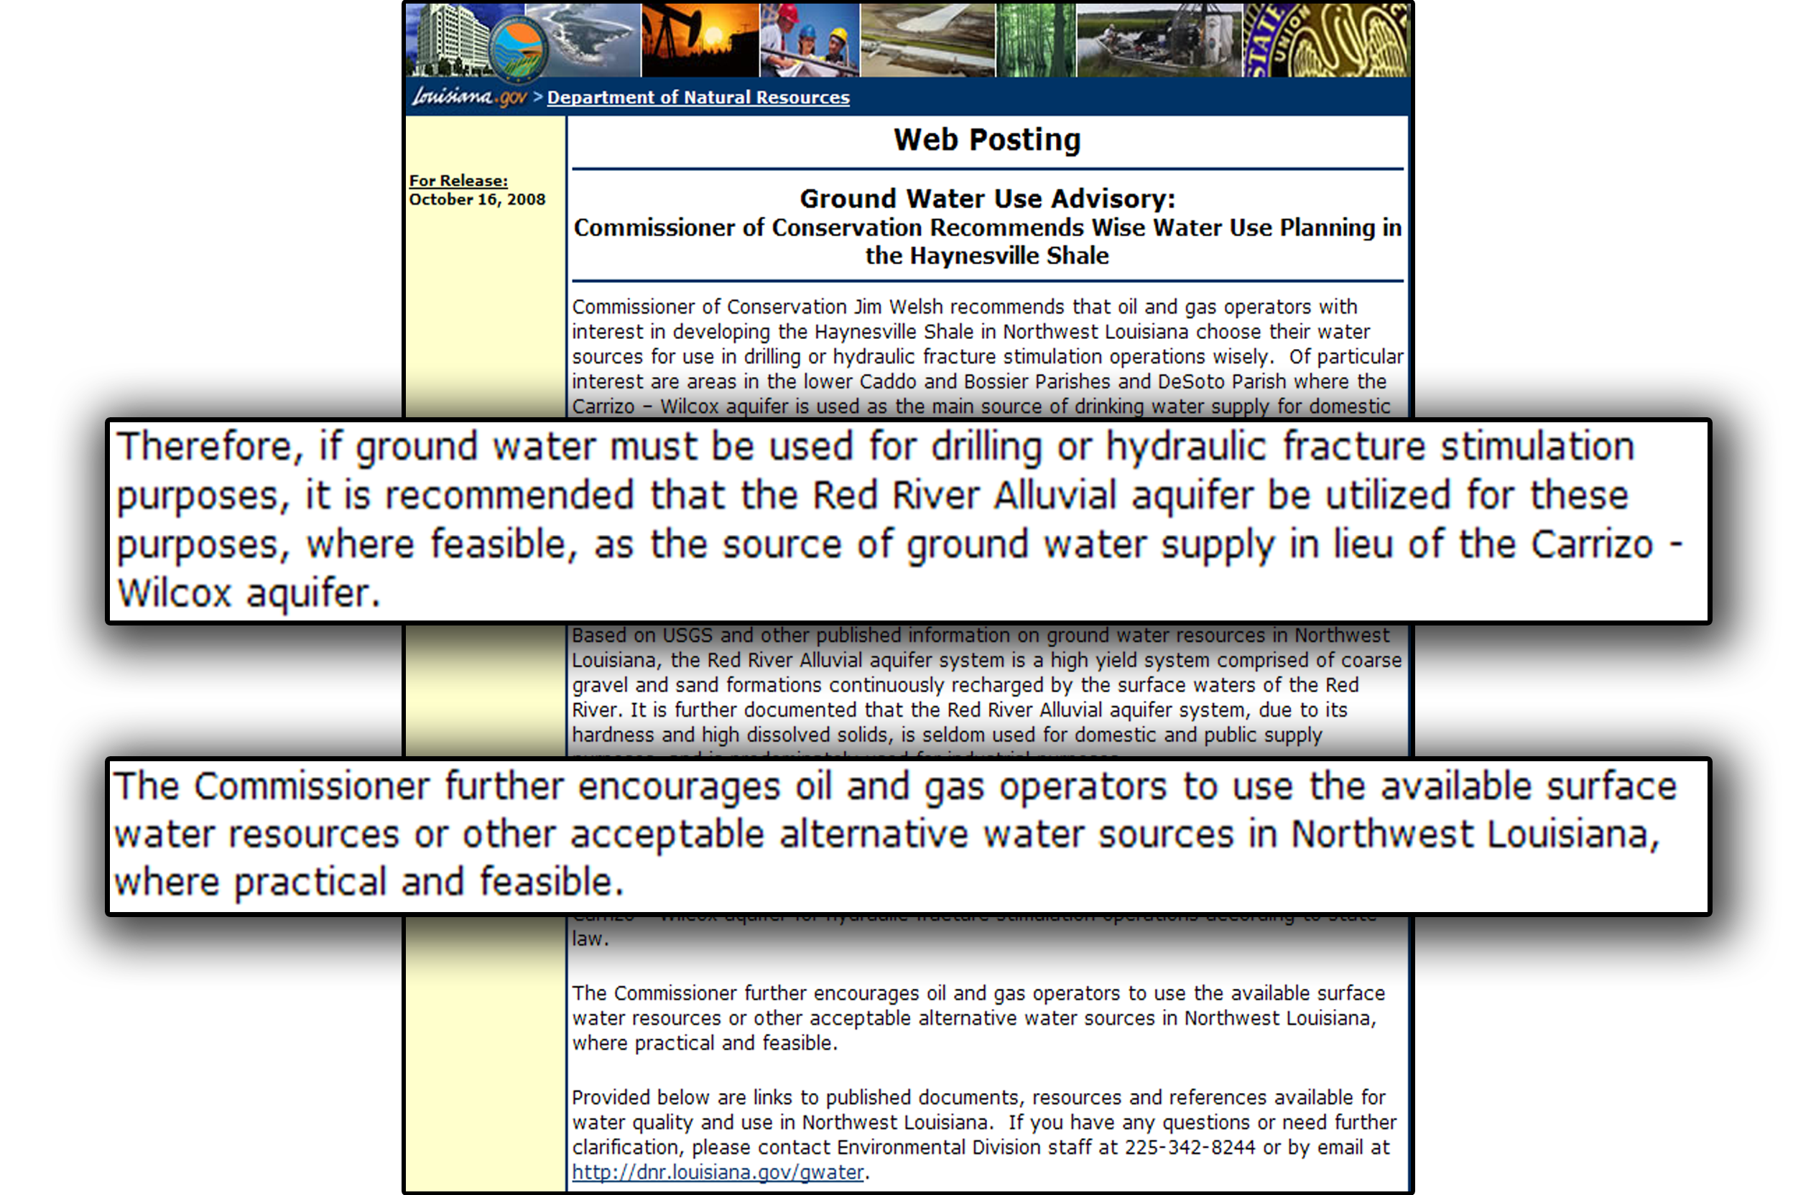
^{Ground Water Use Advisory}
Notes:
In 2008, I issued a ground water usage advisory as the Haynesville Shale activity was ramping up, to encourage companies to help us further protect the underground drinking water aquifers by limiting their use of such water through the use of as much surface water as possible.

Slide 13
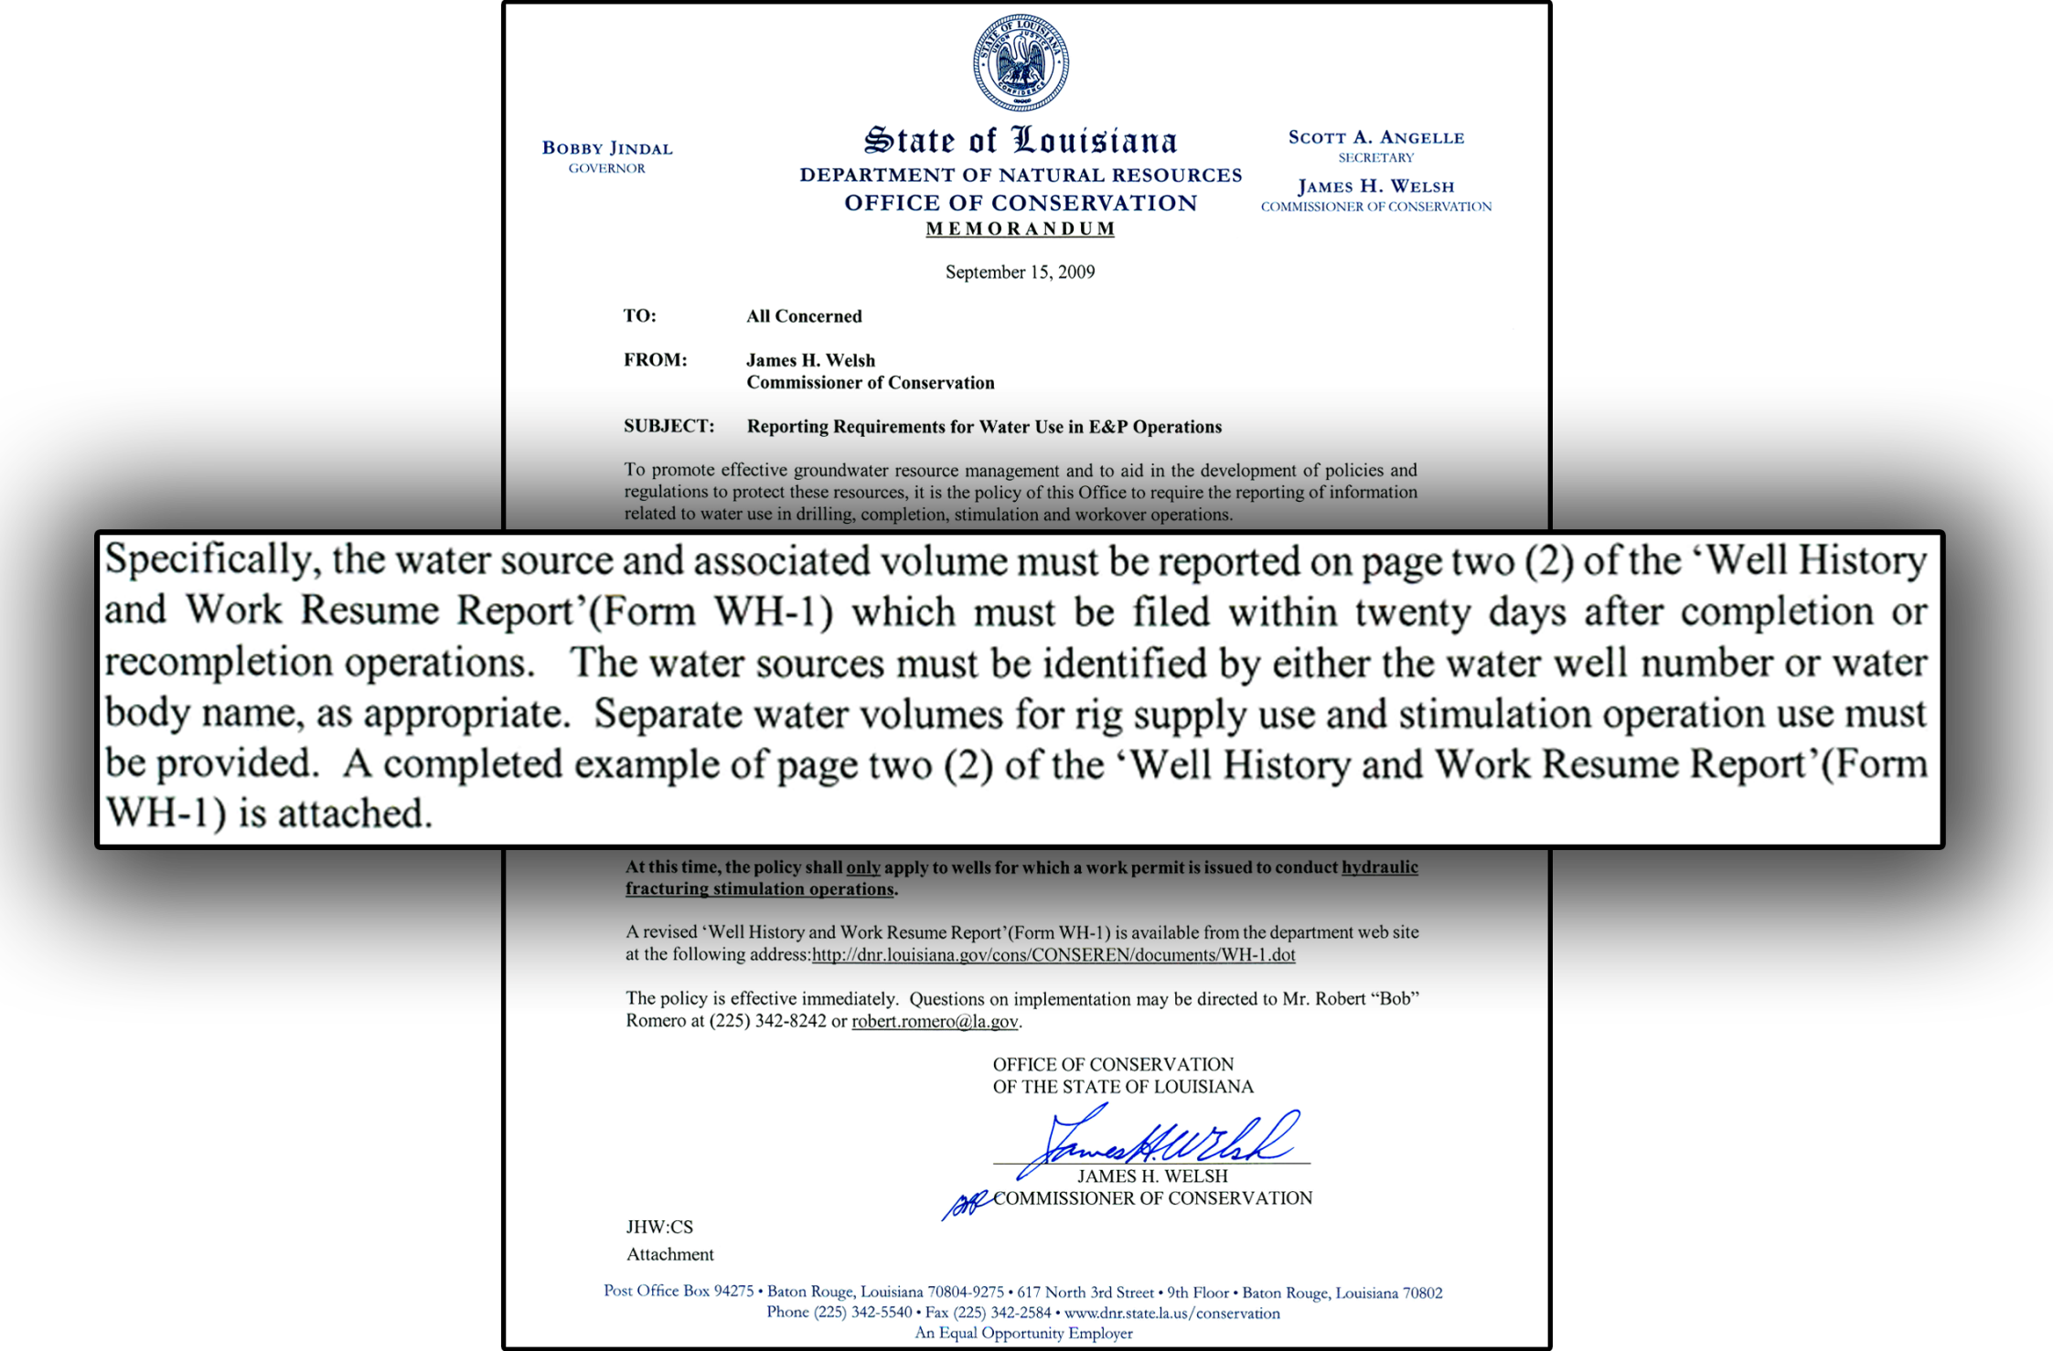
Directive for Frac Water Reporting
Due to revisions of the WH-1 form, water source and associated volumes are now reported on page 3.
Notes:
This directive was issued during the Haynesville Shale activity of recent years as well to help us manage the frack water usage with the high volume of drilling activity happening at that time.

Slide 14
Waste Management
Exploration & Production (E&P) Wastes primarily include:
  Drilling fluids
  Flowback water
  Produced water
E&P Waste regulations ensure proper disposal to minimize environmental impacts of resource development.
Manifest and reporting systems ensure transparency and accountability.
Waste Management options include:
  Onsite disposal using conservative limiting criteria
  Well injection
  Commercial disposal
  Recycling in limited cases

Slide 15
LAC 43:XIX.118
Hydraulic Fracturing Rule
Effective as of October 20, 2011
Must file application with and receive work permit to hydraulically frack from the appropriate district office (Lafayette, Shreveport, & Monroe) prior to beginning fracking operations. Sec. 118.B.
Following completion of hydraulic fracturing the operator must file a Well History and Work Resume Report (Form WH-1) in accordance with Sec. 105 & Sec. 118.C.
LAC 43:XIX.105 requires:
  At least 12 hours prior notice must be given to the manager of the appropriate district office, so that a Conservation representative may have a chance to witness the fracturing operations.
  Within 20 days of completing work under the work permit, the work must be described on the Well History and Work Resume Report and submitted to the appropriate district office.

Slide 16
What Must Be Reported?
With the Well History and Work Resume Report (Form WH-1), the following information must be reported:
  Types and volumes (in gal.) of hydraulic fracturing fluid used in the operation.
  A list by type of all additives used during hydraulic fracturing operations. Specifically list the following for each type:
    Specific trade name and suppliers.
  List of chemical ingredients in fracturing fluid subject to requirements of 29 CFR 1910.1200(g)(2) and their associated CAS numbers. Also specify for each chemical ingredient:
    Maximum ingredient concentration within the additive expressed as a chemical by mass of each chemical ingredient;
    Maximum concentration of each chemical ingredient expressed as a percentage by mass of the total volume of hydraulic frac fluid used.

Slide 17
How to Report?
On the Work History/Well Resume Report (Form WH-1) submitted to the appropriate district office within 20 days of completion of the hydraulic fracturing operations.
Frac Focus Chemical Disclosure Registry – online accessible registry sponsored by Groundwater Protection Council and the Interstate Oil & Gas Compact Commission.
  Fracfocus.org
  Search for specific well information by location, operator, well name, etc.
  Under new reporting requirements, must report within 20 days of completion of hydraulic fracturing operations.
  Reporting on Frac Focus does not fully replace WH-1 Requirement.
Similar Publicly Available Websites.

Slide 18
Confidential Information
Like similar statutes or regulations in other jurisdictions, the new fracturing information reporting requirements provide that specific chemical ingredient identity and CAS numbers entitled to trade secret designation pursuant to 29 CFR Sec. 1910.1200(i), do not need to be reported.
When a trade secret is claimed by the party entitled to make such a claim, then the following information must be provided:
  The chemical family of the trade secret ingredient; and
  A statement claiming that trade secret protection is being made.
    Statement may be as simple as stating that the ingredient is “privileged”, “proprietary” or a “trade secret.”
Despite this protection, no party can withhold trade secret information from a health care professional when such disclosure is required by state or federal law.

Slide 19
Public Information
The majority of information collected by the Office of Conservation is available to the public free of charge through the DNR website – SONRIS (www.sonris.com)
  Access to the DNR Database
  Access to map-based (GIS) information (Geographic Information System (GIS)
  Access to images of documents on file
Notes:
Website info for accessing information from Conservation

